Slide 1

展會智能化
Digitalization in Exhibitions Industry

Slide 2
勵展博覽集團大中華區 - 國內專業的展覽會主辦機構
勵展博覽集團是勵訊集團（RELX Group）的成員之一，勵訊集團是全球資訊解決方案提供商
在全球38個辦事處擁有3900名展會精英
每年在全球30個國家共有超過500個展覽會，並服務於43個行業
2016年有超過700萬行業專業人士參加我們的展會
在多個國際市場擁有領先地位，全球網路支援客戶，为客戶找到最有效的途徑，拓展出口市場

Slide 3
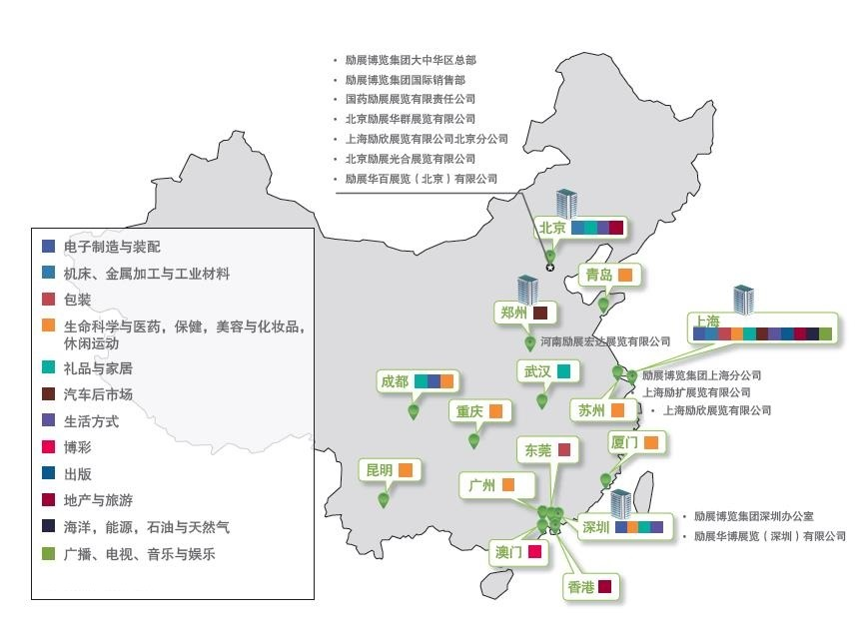
勵展博覽集團大中華區
辦事處、展會行業及地區分佈(2016年)

Slide 4













励展博览集团大中华区 —— 部分知名品牌展会

Slide 5
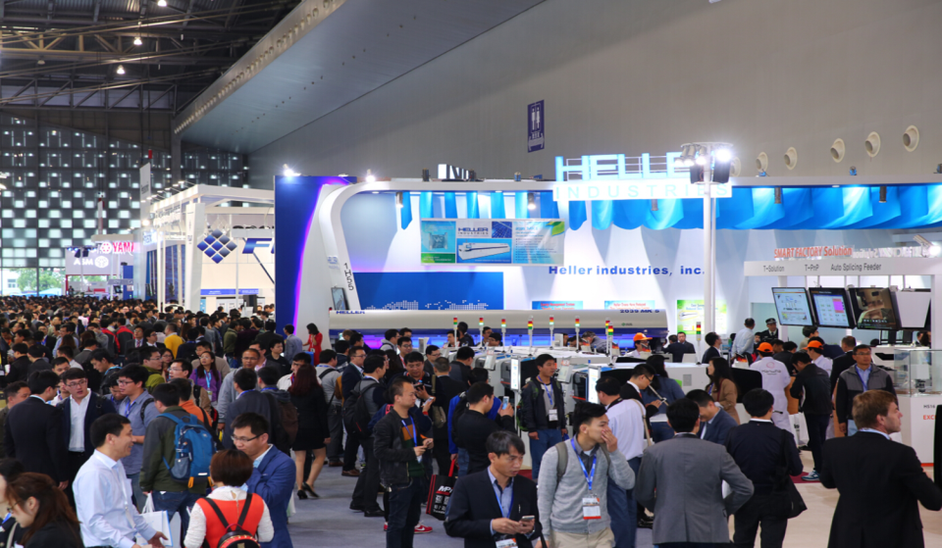
以往的現象 Old World
Photo of people
Notes:
This is our world, as the exhibitions organsiers, we are proud to provide a very busy show with packed gangways.

Slide 6

以往的現象 Old World
客户
客户
客户
客户
Notes:
However, this is no longer good enough, how are we going to identify targeted buyers for our exhibitors from this crowd become a challenge.

Slide 7
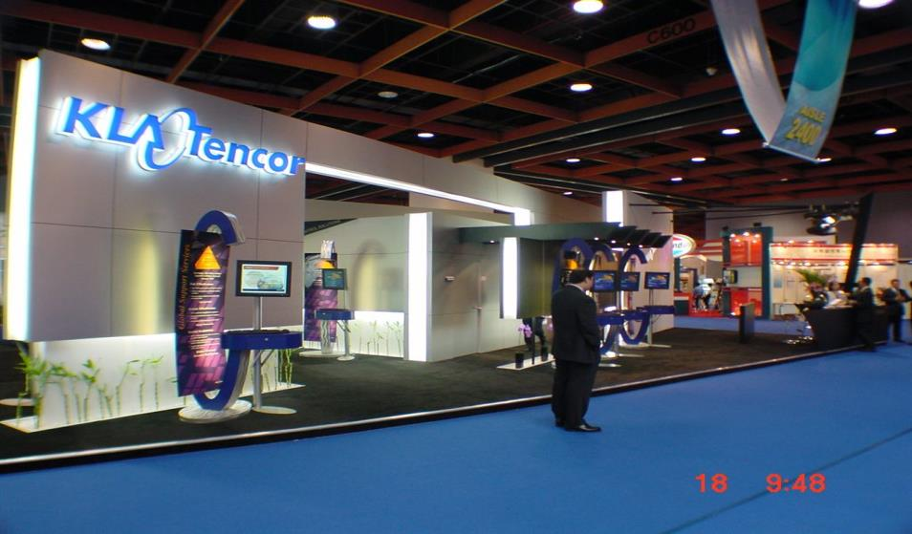

我們的客戶 Customer
Pls put in a photo with exhibitors waiting for customers impatiently, not a happy face
Notes:
Our customers are no longer happy with waiting……..

Slide 8
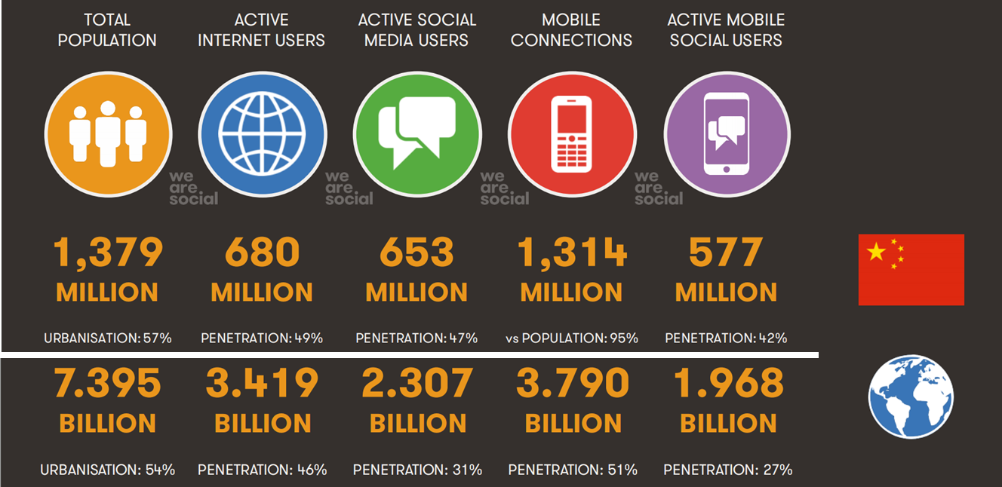
我們的世界正在改變 A Changing World
Notes:
May I invite you to look at our new world, people are using new way to get connected. Out of the 7 billion total population in the world, 46% of them are active internet users, that means, close to half of our customers are getting more instant information and no longer satisfy with outdated information. Waiting to get latest information about the industry once a year is it good enough for them? On top of them, they are very socially connected and using mobile to communicate, source for information and get support become a norm.

Slide 9






我們客戶的需求與期望已經改變
Expectations had changed
要求投資得到更高的回報
相關及有意義的內容
全年的交流
體驗良好
新的预期！
個性化
Notes:
With our world changed, our customers are having new expectations on their participation, they demand higher and measurable return on their investment, they want to get information and meet buyers that are relevant to them and no longer happy with busy show but not meeting targeted contacts. They also want to get engaged throughout the year with different channels and can’t wait for the next show which usually once a year. They want better experience and highly interactive with their buyers at the event, it is all about individual and our customers no longer happy to receive information that send to everyone with generic content.

Slide 10
新的預期和問題 Solutions
能量化的結果（高品質的買家與銷售線索）
非僅僅是觀眾數字
更高更精准的投資回報
商務配對
客戶分類以及許可营銷
相關及有意義的內容
大資料分析，深入的客戶洞察
全年全年的交流
社交媒體戰略和展會電子化
展會以外的互動
體驗良好的貿易展會
手機程式應用，
銷售線索電子化，直播
展會的新形態
個性化
大資料分析，智慧营銷
拒絕大量混雜的宣傳活動
Notes:
So how these new expectations from customers affect us? The higher and measureable return on investment mean we need to deliver highly qualified contacts with results instead of just telling our customers that the show had achieved record-high of visitors number. In order to achieve that, we need to look at implementing highly targeted and result-oriented match-making before and during the show. We also need to segment our customers according to their needs and behavior in order to put together relevant content for different group of customers. As a lot of countries implemented New Data Privacy Policy, we need to ensure we are able to engage our customers with content that add value to their business, we need to ask for permission before we send information to them. To overcome this, we need Big Data that tell us how we should segment our market and provide relevant and useful content that engage each of the targeted group of customers. Our customers also expect to get connected throughout the year with different channels and platforms, it means that as the organisers, we need to provide opportunity for our customers to meet buyers beyond the show floor, this will enhance the brand stickiness as well as customers’ engagement. I will explain later in my presentation how social media strategy and digital industry portal to help creating these virtual communities. We are expected to provide new ways to keep the face to face experience at the show floor very dynamic, keep our customers excited and at the same time, engage industry players who are not attending the show. More importantly, it help to pro-long the stay of our visitors and provide information and records of contacts effectively after their visits. Personalization: our customers no longer happy with generic information, as the attention span is getting shorter, our message need to be punchy and relevant, again, Big data analytics will be able to help us to create highly relevant content by understanding their real needs and behavior, there are also a lot of new marketing automation tool that help us to track effectiveness.

Slide 11
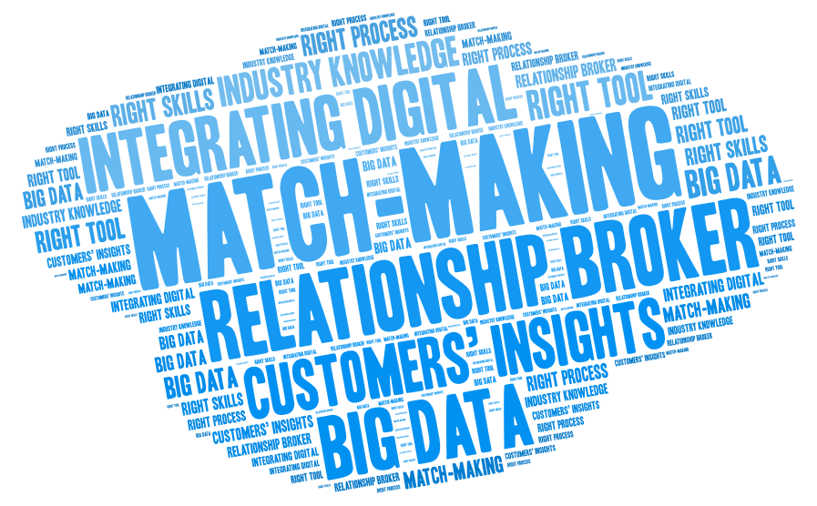
Notes:
Match-making help us to transform from a ordinary exhibition organisers to “Real” Relationship Broker. There is no rocket science but Art of utilization of big data and customers’ insights, supported by right tool and a proper process in place, it bring results to our customers.

Slide 12
商務配對 Match-making
關係仲介
整合電子化，大資料字，客戶洞察以及產業知識
正確的工具，正確的流程，正確的技巧
清晰的配對邏輯
電子化配對工具
清晰的資料
現場配對監督
客服中心
必須— 清晰的目標
選擇性—VIP關係經理

Slide 13
商務配對程式 Match-making process
1
設定目標
2
捕捉資料– CRM 到位
3
鑒定配對邏輯--深化產業邏輯
4
加強客戶展商和觀眾的參與
5
收集客戶洞察
6
7
配對
實現配對結果 —手機，電郵和社交媒體
8
用電子工具促進實施現場會議-手機，APP，社交媒體

Slide 14
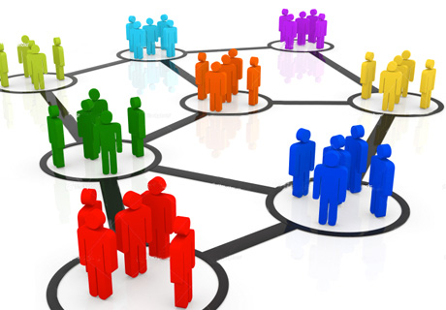
全年交流 Community
一個多管道的市場行銷計畫能提高你的品牌的凝聚力
一個成功的社交媒體行銷計畫需要好的科技，嫺熟的人員，諮詢顧問，供應商和適當的“內容”戰略
365產業平臺

Slide 15





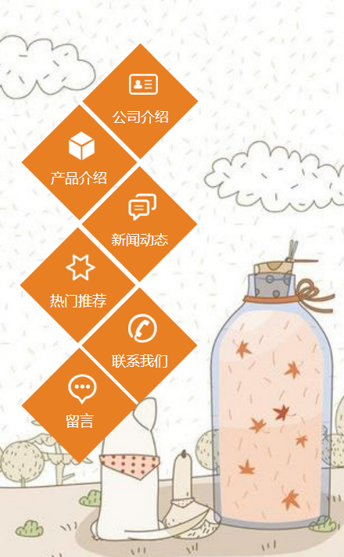
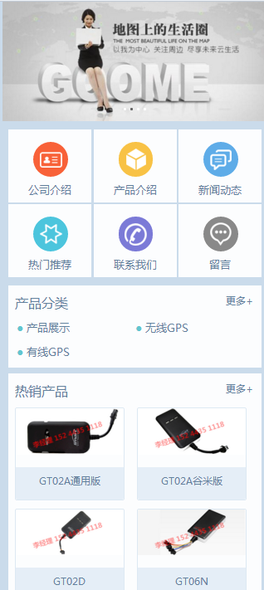



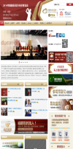














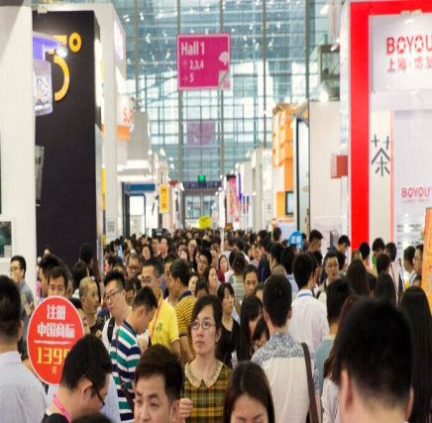


一個完整的平臺 Integrated Platform
电子市场营销活动
线下活动
网站
微网站/产业平台
手机 App
社交媒体
Notes:
As I explained earlier, our customers are no longer happy with 1 way communications. We need to keep them engaged throughout the year via different tools, platforms. By understanding their needs, engage them via different channels, we will be able to bring them to our show and deliver the right value by enabling them to meet the right contacts. This is a positive cycle that help the show brand to grow.

Slide 16
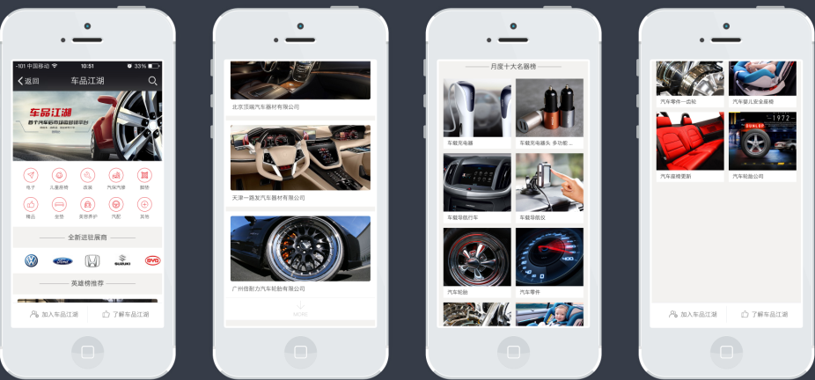
365 行業平臺
全年延伸展會價值 Extended value
手機應答的網站
快速查詢公司和產品
宣傳優先順序展商和新產品

Slide 17
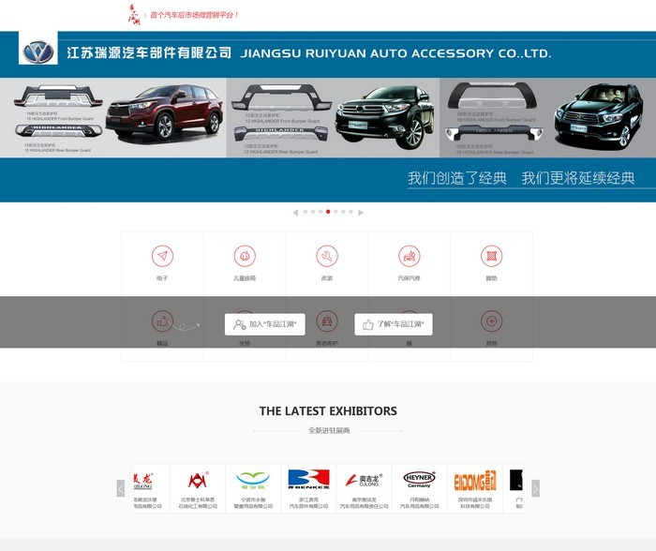
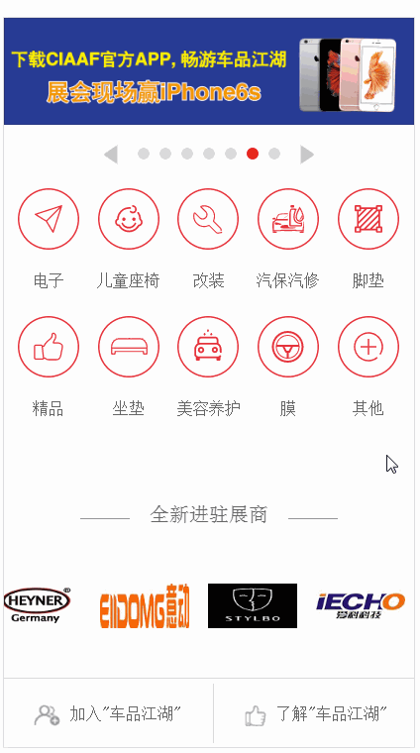
手機端365行業平臺 Industry Portal

Slide 18



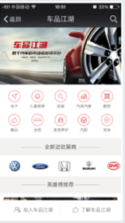
客戶移動端
的體驗
Mobile Experience
商務配對
微網站
展會網站
手機App
(Reed Connect）
)
微信公眾號
365 行業平臺
觀展登記

Slide 19
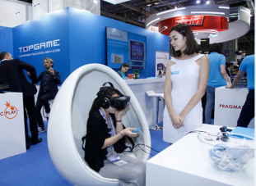
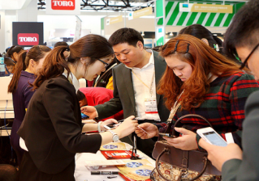
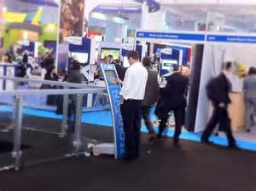
體驗型展會 Experiential Shows
展會體驗是觀眾和展商評估結果的關鍵指標，使用電子智慧工具以便：
提升體驗
提升與觀眾，展商的投入感
加強與展館外的業內人士的交流
提供新的形式（VR)

Slide 20
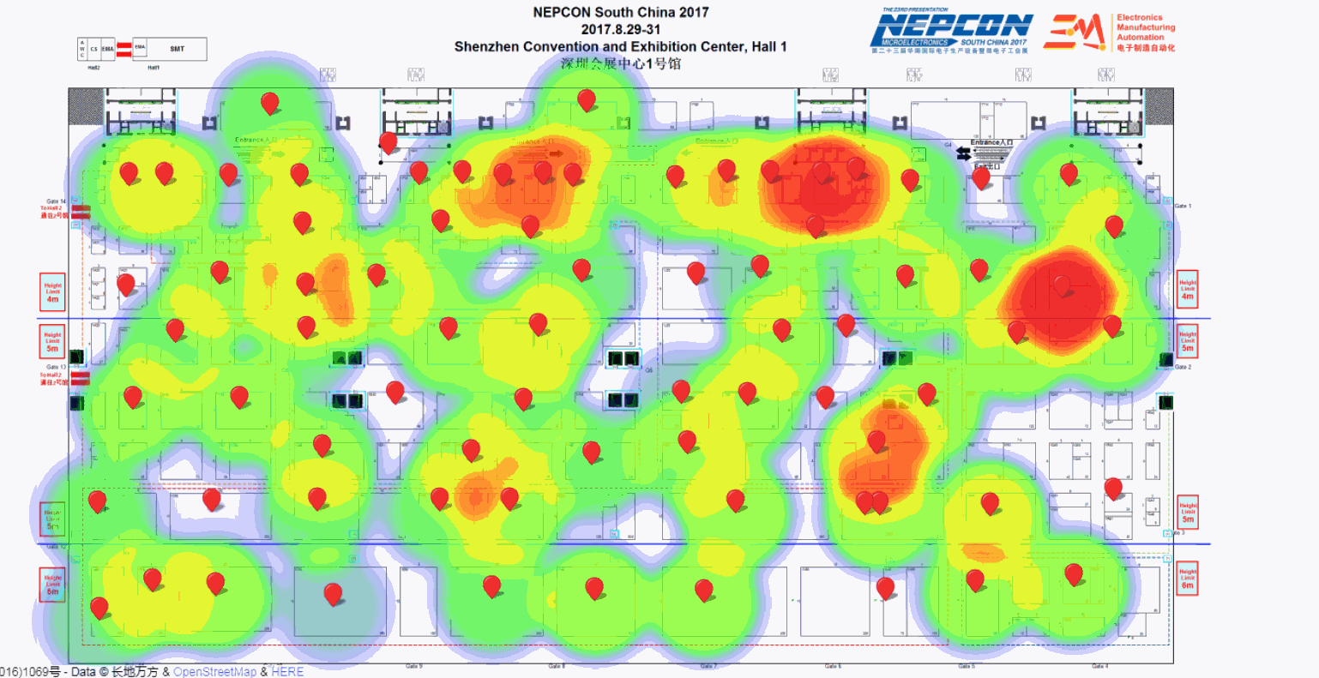
動態熱力圖 Heat Map

Slide 21
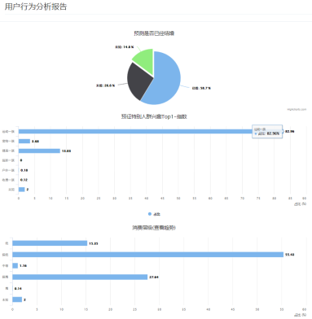
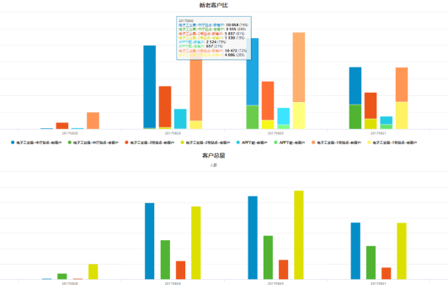
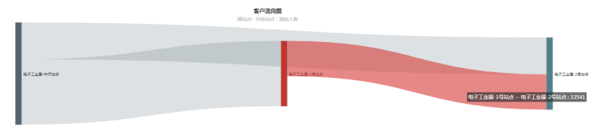
即時大數據呈現 Big Data

Slide 22
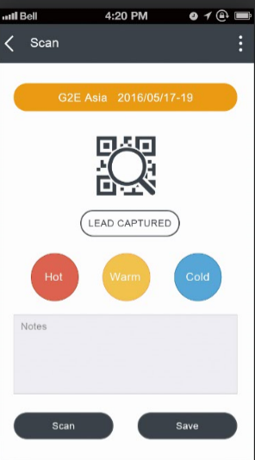
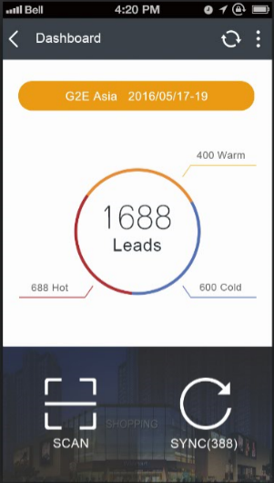
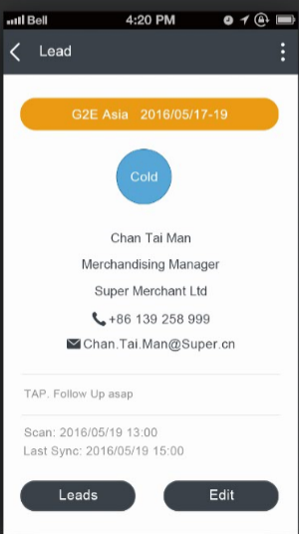
Reed Connect APP
登录
DASHBOARD仪表盘
核对
扫描
使用密码登录
扫描即可备注产品，价格和客户
所有掌握的销售线索和产品
核对销售线索和产品信息

Slide 23
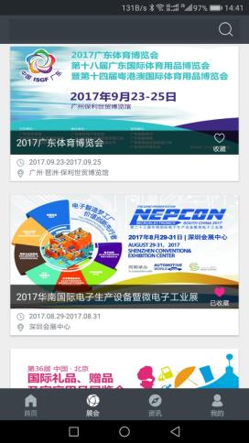
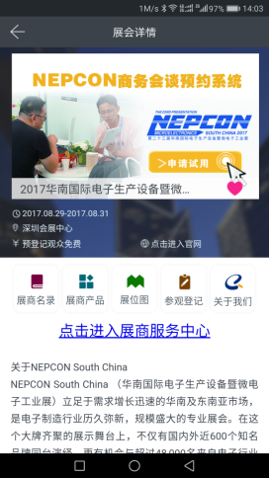
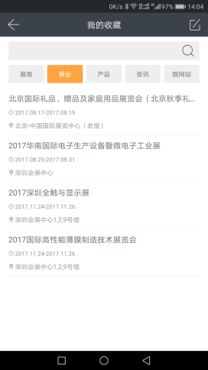
勵展之旅 Reed Journey
√
Subscripted Successfully!

Slide 24
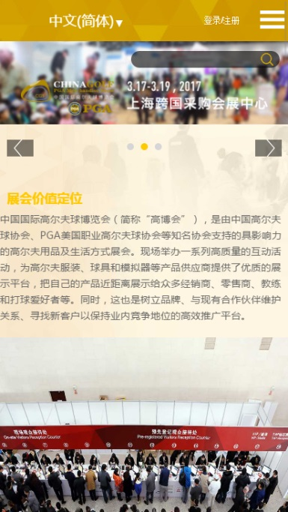
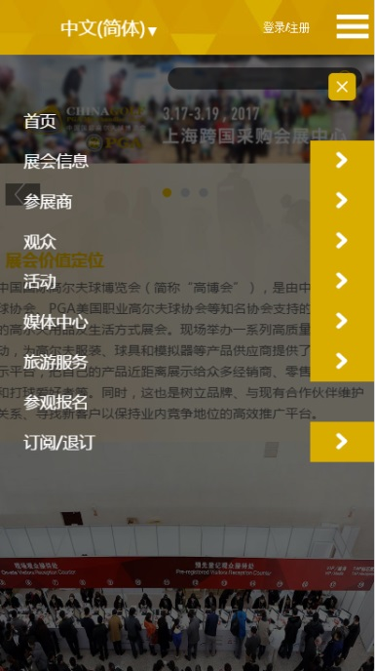
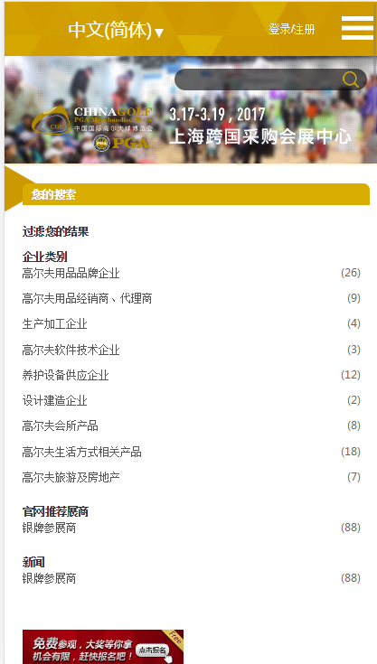
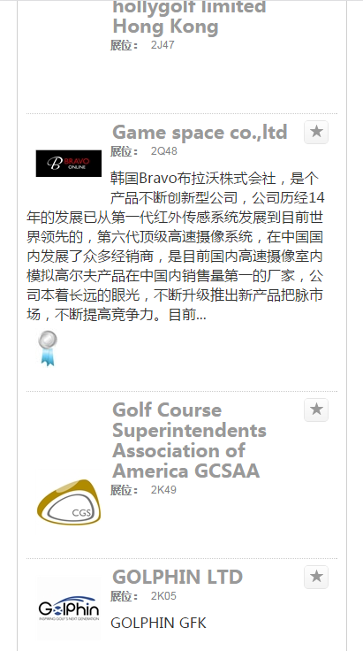
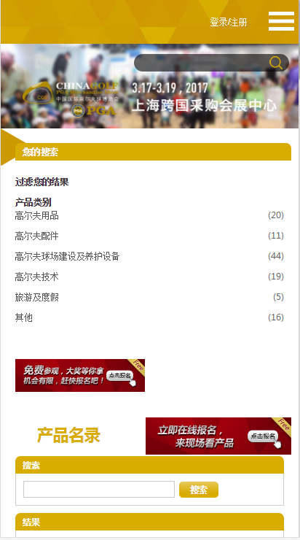
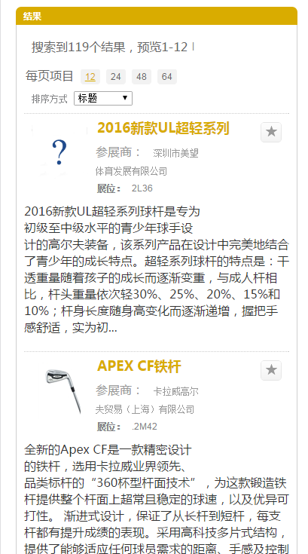
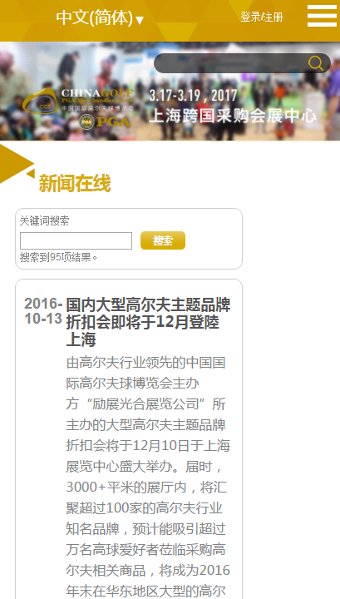
展商和產品目錄 Directories

Slide 25
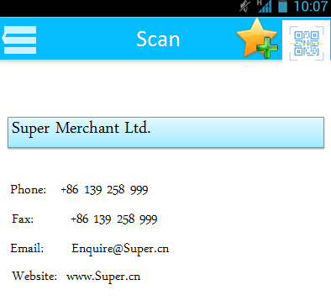
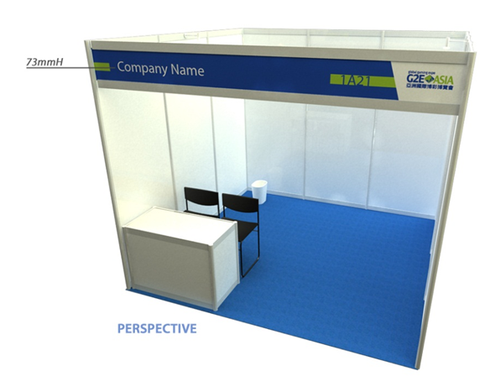
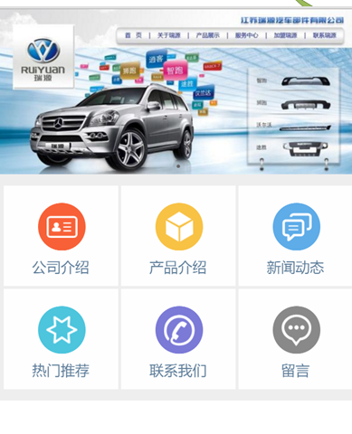
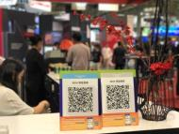
觀眾可在展位元掃描展商及展品資訊 Scanning
扫描展位的QR二维码！
扫描并记录展商的INFO

Slide 26
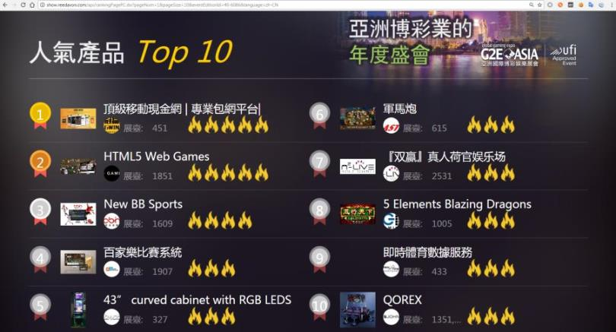






線上TOP人氣產品 The Big Hits
线上浏览产品
线下扫描产品
产品得分
热度指数升高

Slide 27
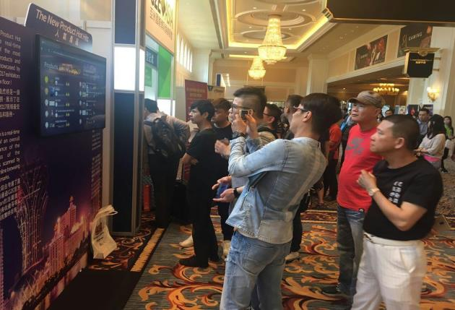
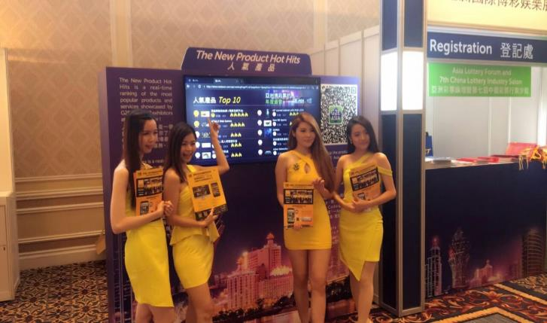
優勢 Benefits
觀眾
展商
吸引觀眾眾多注意力到展商產品
對觀眾尤其是新觀眾具備一定的參考價值
更好連接線上和線下
為他們新產品能夠獲得更多曝光機會感到滿意
對中小企業，有可以排名前列的機會

Slide 28
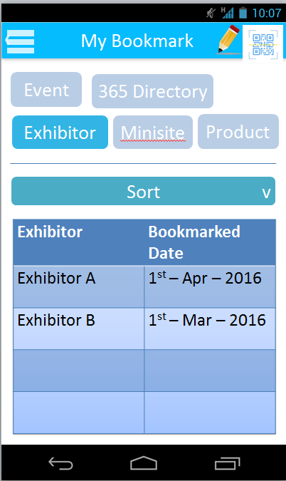









勵展之旅 Reed Journey
下載Reed Connect
展商展位元掃描
記錄展商和產品資訊
新产品的资讯
參觀勵展展會
1) 保存掃描的資訊以便展後分析供應商和下單
2）通過Reed Connect接收更多的勵展展會資訊
3) 使用Reed Connect安排現場會議和記錄會議紀要
觀眾
Notes:
This is a Reed Visitor Journey, visitors come to the show, download the “Reed Connect” Mobile App, they are able to scan information of exhibitors and products for future references, they will also be able to write down notes of their meetings. All these information will go back to the back-end server that give us a lot of insights on their behaviour. They can opt in to receive more news from the organisers that help us to get connected throughout the year.

Slide 29
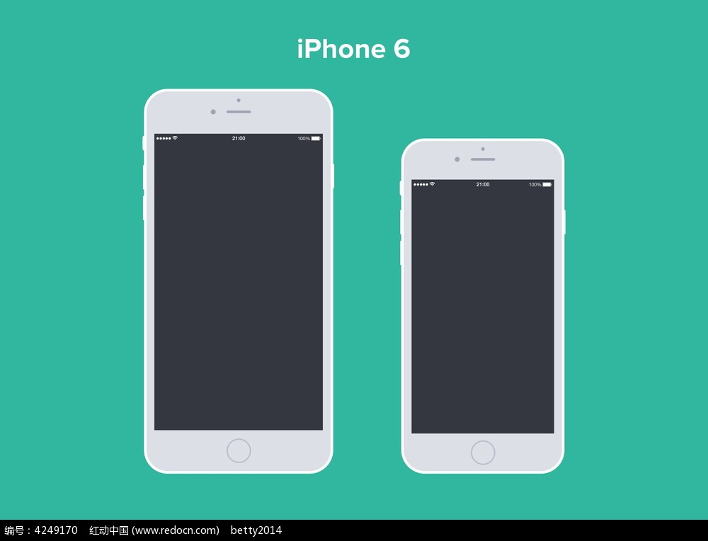
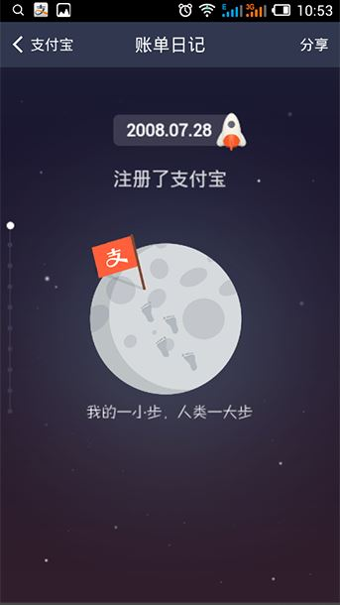
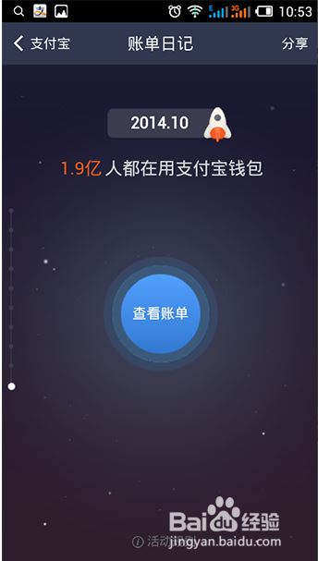



個性化Personalization
微信公眾號 Wechat Account
NEPCON NEPCON with Me
NEPCON 我与NEPCON
2008.3.16
2016.3.16
Registered NEPCON
Over 23,356visitors registered ! Come to NEPCON China to see how many industry leaders you may know!
Click here to view more↓
TAP
TAP
N
Visitor registration
NEPCON China
Visitor registration
NEPCON China

Slide 30
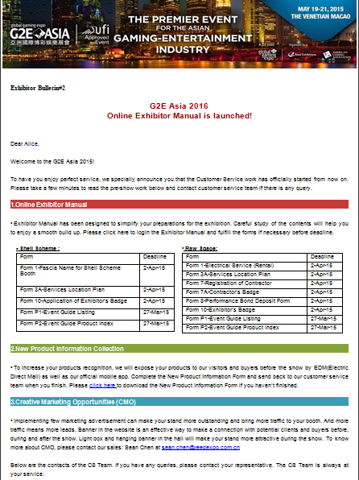

個性化 Personalization
電郵溝通 Email
短信溝通SMS
Dear Kelly,
Welcome to register Global Gaming Expo 2017! G2E Asia is the industry event offering one-stop sourcing platform of gaming and entertainment products to the forward-looking casino operators in Asia.
See you on May 16-18 2017 at Venetian Macao!

Slide 31
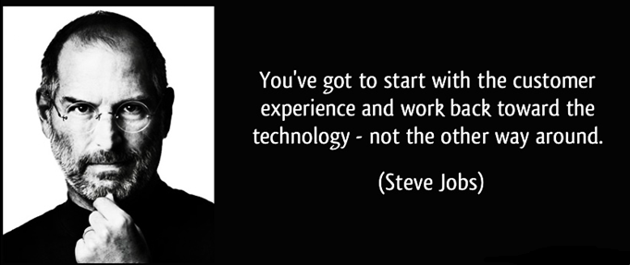

你該從客戶體驗出發，然後再使用技術來支援
Notes:
Like what Steve Jobs said. You have got to start with customer experience and work back toward the technology, customers are the centre of all our work, using digital and technology just to enhance the journey and the result.

Slide 32
Thank you!

