Slide 1
Macau and the Asian MICE Industry
MCEA Forum
Outlook of the Asian MICE Industry and Macau’s Role and Positioning in this Development

Slide 2
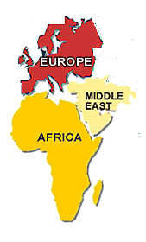
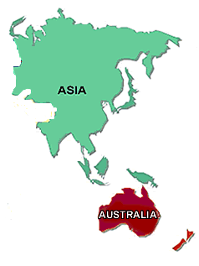
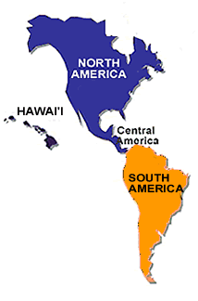
The Asian Century for Conventions
Globalization
  As the world goes global so must international associations. Members demanding engagement in Asia as a new market.
Tri-polar event rotation
  The association world is now seen as tri-polar
    Europe, Africa and Middle East
    The Americas
    Asia
    This will mean more meetings
    happening in Asia
BRIC
  The biggest emerging economies
  are Brazil, Russia, India and China. China being the most important.

Slide 3
Asia is leading the world’s growth in numbers of international conventions occurring
Comments
Asia’s market share of international conventions is rising as associations seek to globalize their membership and market delivery.
In addition to more meetings adding Asia to their rotation patterns, more global associations will seek to establish regional offices in Asia, thus driving an increase in Asian regional meetings.
Asia’s CAGR is 9% for the last 10 years, and this trend should continue.
CAGR*
Source: ICCA (2011)
* CAGR: Compound Annual Growth Rate

Slide 4
China has grown in market share of international conventions coming to Asia
International Conventions in Asia Pacific
(1998-2010)
Other 16.6%
Hong Kong 4.1%
India 5.0%
Taiwan 6.9%
Thailand 4.4%
Malaysia 5.9%
Singapore 6.8%
2010
Korea 9.3%
Cairo
25.8%
2,008 international conventions were held in Asia Pacific in 2010 (19%)
Mainland China, Hong Kong and Macau had 383 conventions for a 19% share of Asia Pacific held meetings.
Macau hosted 19 conventions , or 5% of the international conventions coming to China
Australia 11.9%
China 14.0%
Japan 15.2%
Source: ICCA 2011

Slide 5
Why Macau?
Best facility packages in Asia
Best venue in Asia
Best hotels in Asia
Great value
New destination appeal
Great shopping
Unsurpassed entertainment
Glamorous
Safe
Convenient
Unique heritage
Appealing culture
Outstanding food
Human scale
In China
Don’t need a visa

Slide 6
Key Asian Destinations
 | Hotel Stock | Facility Package | Access | Logistics | Appeal / Image | Support | Safety and Stability | Overall
Singapore | 4 | 4 | 4 | 4 | 3 | 4 | 4 | 27
Hong Kong | 4 | 3 | 4 | 3 | 4 | 2 | 3 | 23
Tokyo | 4 | 2 | 4 | 2 | 4 | 2 | 4 | 22
Shanghai | 3 | 3 | 3 | 3 | 4 | 2 | 4 | 22
Seoul | 3 | 4 | 3 | 3 | 2 | 3 | 3 | 21
Kuala Lumpur | 3 | 4 | 3 | 3 | 2 | 3 | 3 | 21
Beijing | 3 | 3 | 2 | 2 | 4 | 2 | 4 | 20
Macau | 4 | 4 | 2 | 3 | 2 | 1 | 3 | 19
Bangkok | 3 | 3 | 4 | 2 | 2 | 3 | 1 | 18
Taipei | 2 | 2 | 3 | 2 | 2 | 3 | 4 | 18
Poor
Fair
Avg
Good
Great
Notes:
6

Slide 7
How Asia’s Major Destinations Compare
Numbers of International Conventions
GAP
Source: ICCA 2011

Slide 8

Singapore Case Study
Singapore’s Key Strategies:
Reinvention
Strengthening its association connections
Establishing headquarters
Industry training
Well funded bidding office
Ambassador program
Subvention
Comprehensive destination management
Strong Convention branding

Slide 9
How Macau Compares
Key Success Strategies:
Reinvention
Strengthening its association connections
Establishing headquarters
Industry training
Well funded bidding office
Ambassador program
Subvention
Comprehensive destination management
Strong Convention branding

Slide 10




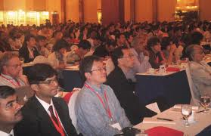
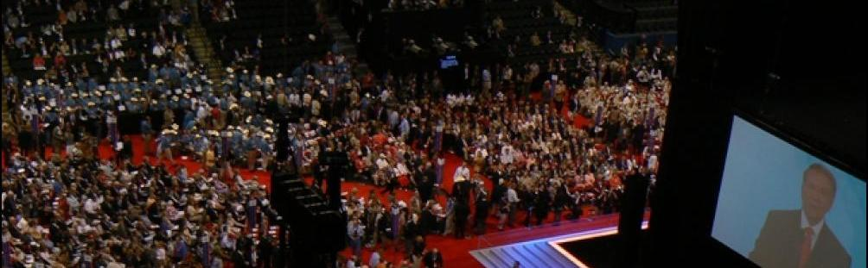

A Successful Convention City Needs……
Experienced Researchers
Experienced Sales People
Bidding
Databases
Business Leads
Priory Accounts
Relationships
Bid Development
Productivity Goals
Strategising
Campaigning
Presenting
Win
Conventions

Slide 11
Thank You

